Slide 1
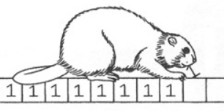
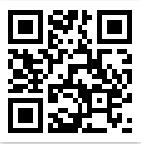
[Poster Describe Research or Software Development Project] Busy Beaver Project Presenter: Or Gamliel Instructor: Dr Anat Paskin Cherniavsky
Contribution/project goal
2. Introduction
3. Methods/algorithms/Alternatives or Design Considerations
4. Selected Approach
5. Solution Description (Algorithms, Modulation, Patterns, Infrastructure, UI, Functionality)
Visit Us
Scan QRCode for full Instructions

